Slide 1
Kludge Protocol
Akash James
Aastha Singh
Shubham Baid
Problem Statement
LEVERAGING AI/ML FOR PLASTIC MARINE DEBRIS

Slide 2
SO, HOW IS YOUR SOLUTION DIFFERENT?
Using Computer Vision and Deep Learning to locate, identify and classify plastic debris over the ocean.
Drones are used to automatically survey and generate structured data
The community can report presence of debris on rivers and coastal areas using their own smartphone or drones… the data is validated by our AI system
Automatically generate community cleanup events with twitter

Slide 3
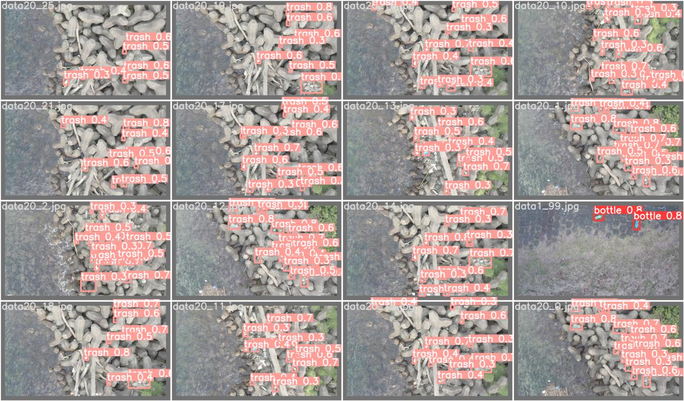
Current Progress
Plastic Debris Localisation
Using YOLOX object detector
is completed.

Slide 4
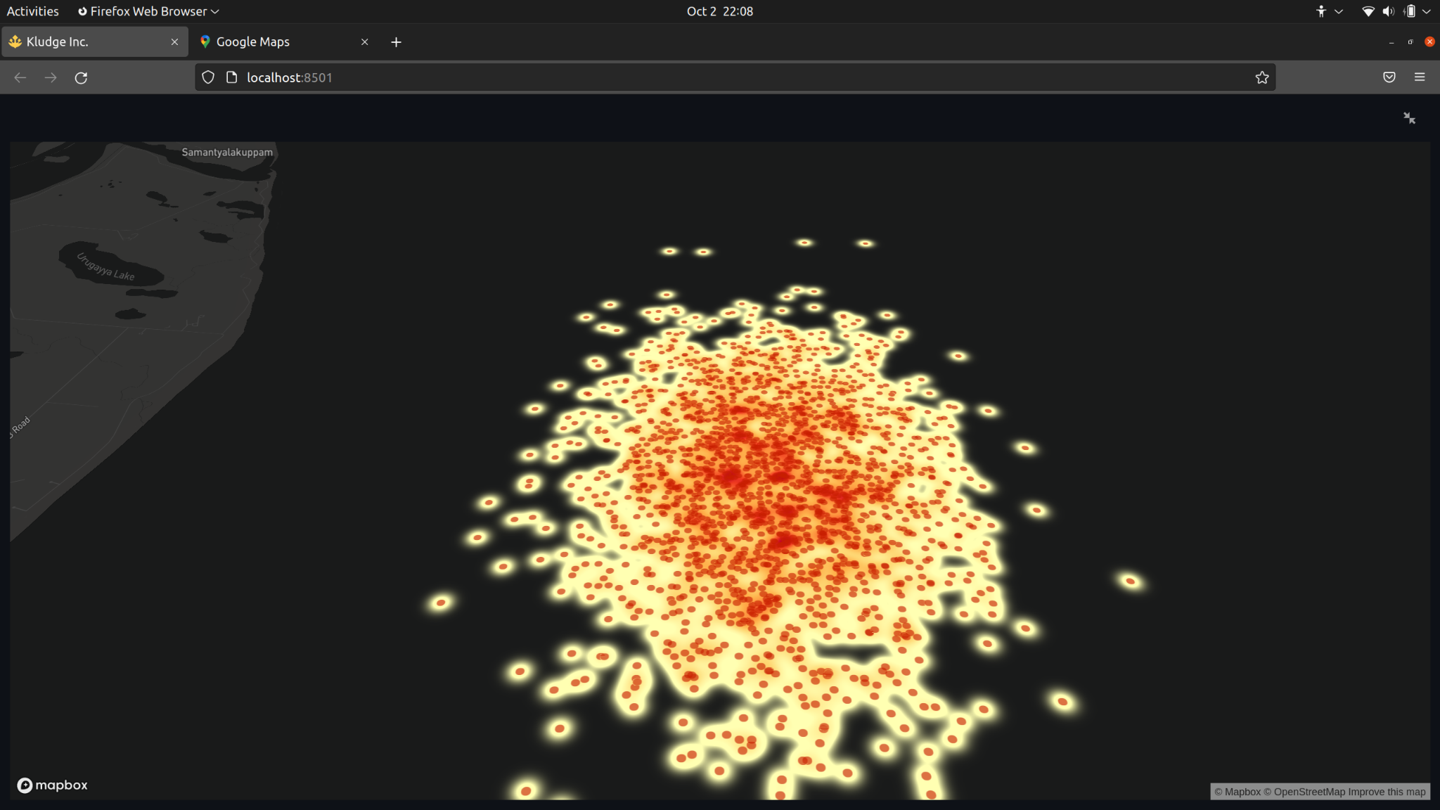
Current Progress
Marine Debris visualisation of Satellite data is complete and integrated with app.

Slide 5
Current Progress
Time Series Visualisation of marine debris density prediction is ongoing.

Slide 6
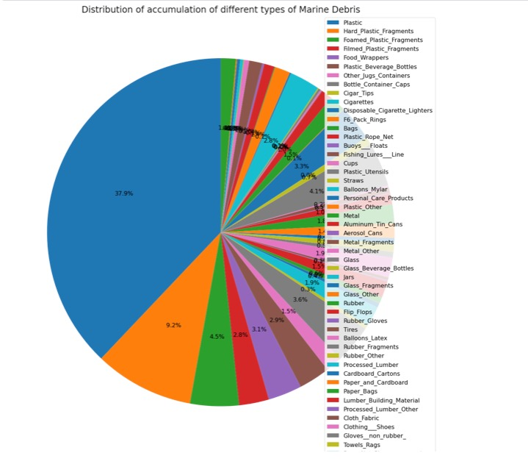
2. Classification between Micro, Meso,
Macro and Mega Plastics is ongoing.

